Slide 1
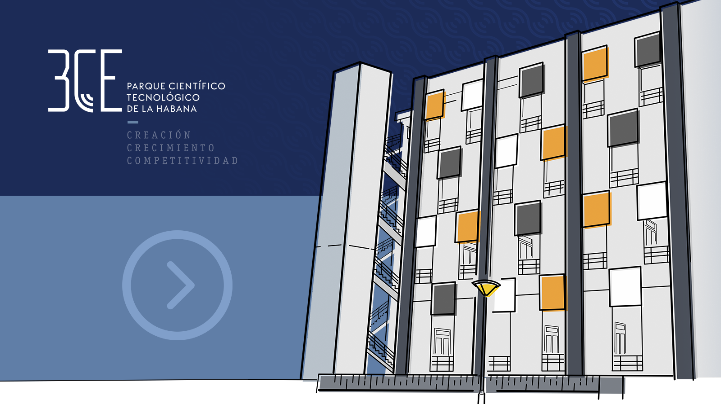

Slide 2
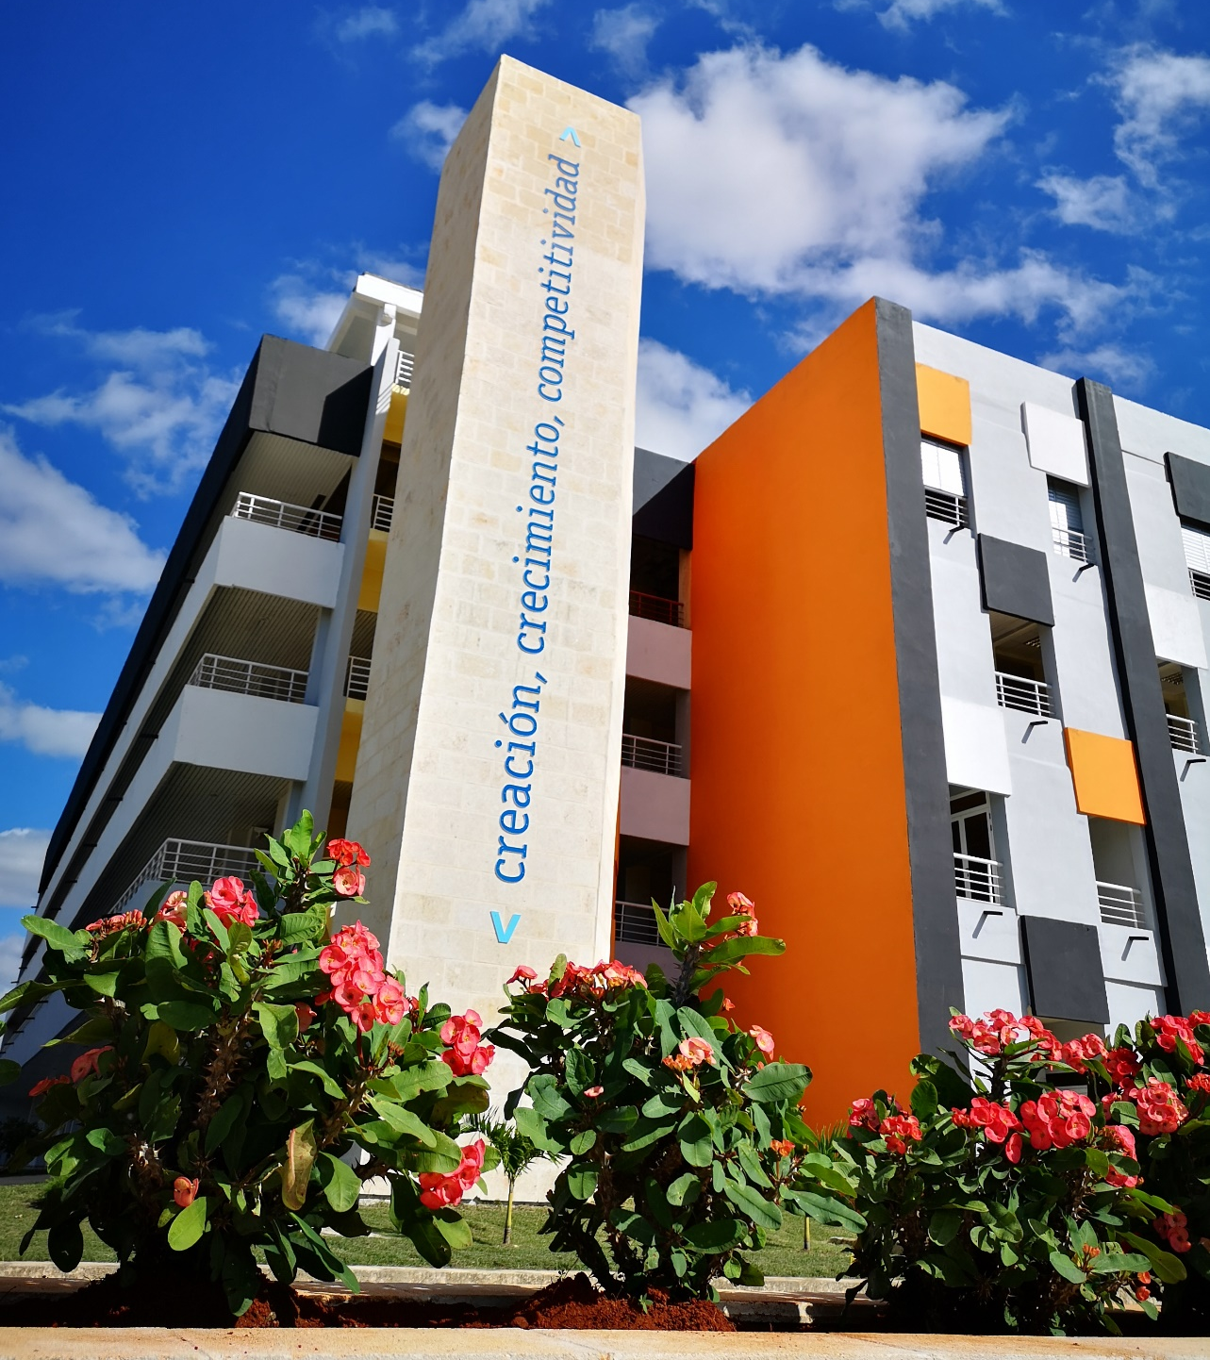
</ SCIENTIFIC & TECHNOLOGICAL PARK >
The Havana Scientific and Technological Park (3CE) is an innovation ecosystem design to support the execution of R+D+i projects and the incubation of new Technology-Based Companies in the ICT sector, which, based on benefits and incentives, facilitates the achievement of high-impact results for economic and social development.

Slide 3
</ TIME LINE: BIRTH / TAKE OFF / GROWTH / MATURITY >
BIRTH
2022
GROWTH
February 4th, 2020
TAKE OFF
MATURITY
2021
2023-2026

Slide 4
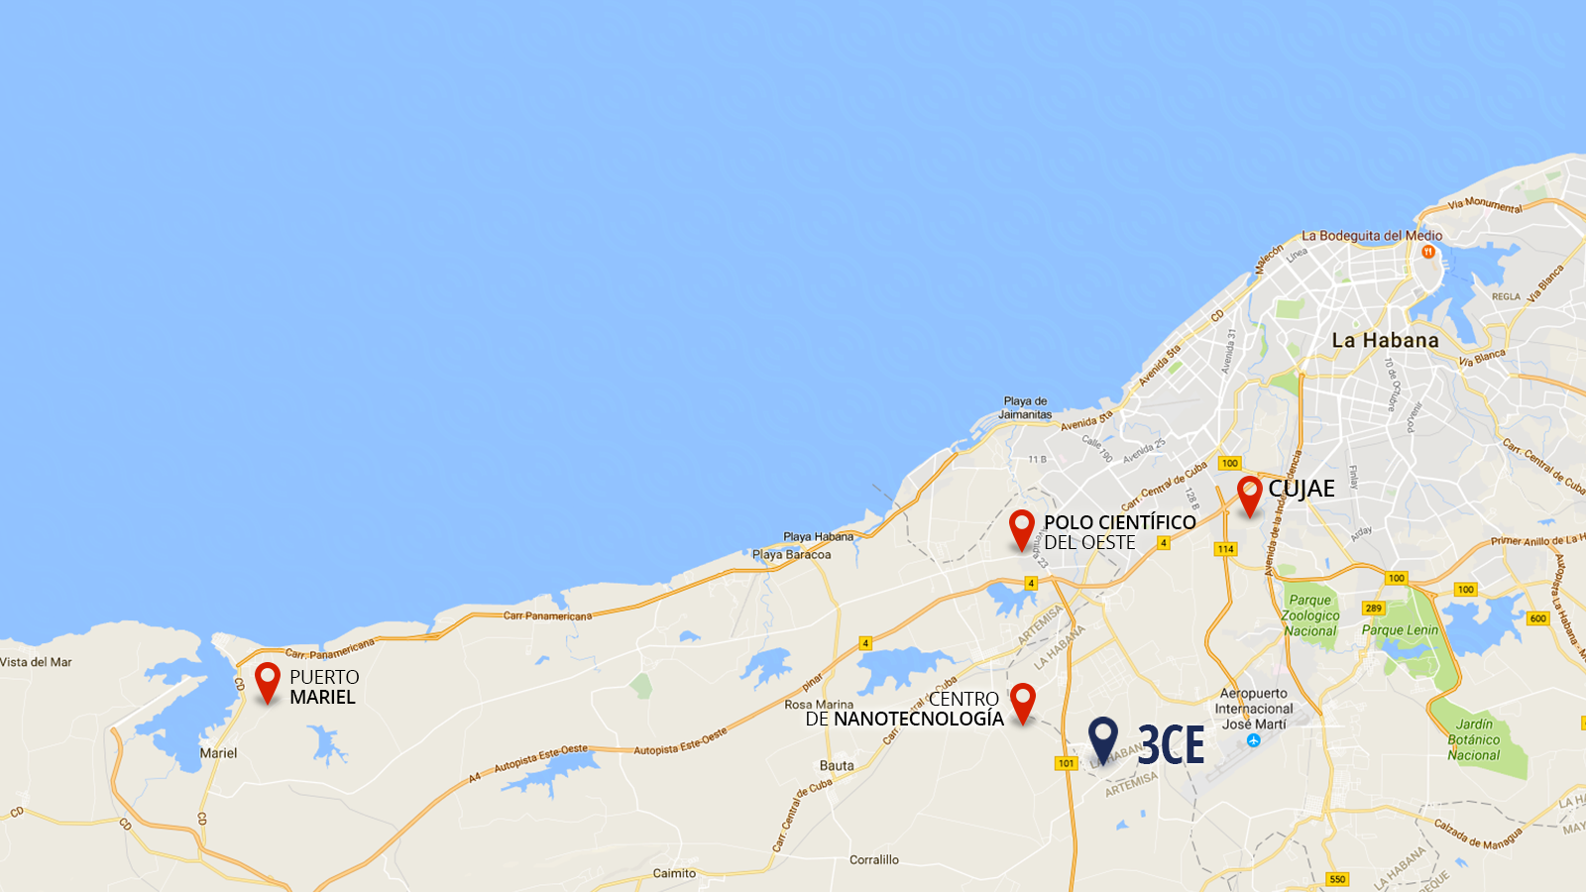
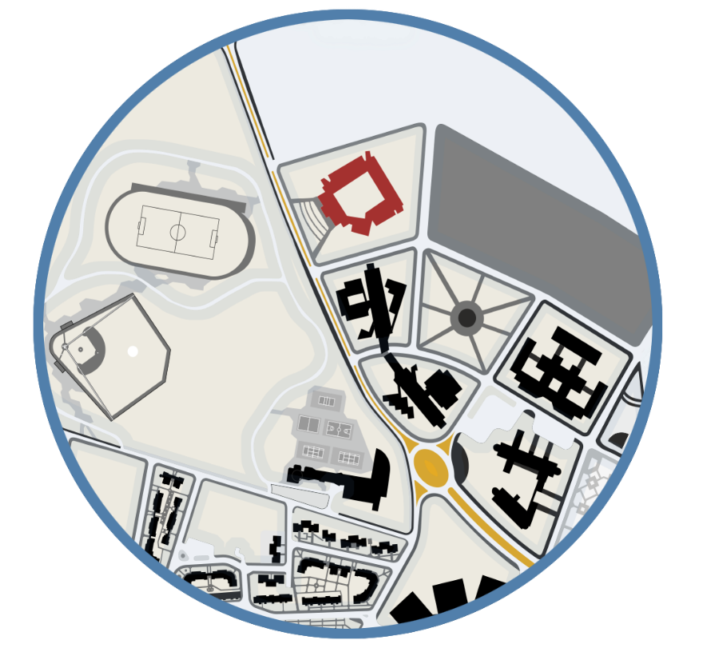
</ GEOGRAPHIC LOCATION >
UNIVERSITY
OF INFORMATICS SCIENCES

Slide 5
</ FUNCTIONAL DIAGRAM >
INPUTS
Value Added Services (Incentives)
OUTPUTS
Main
Actors
Scientific or
Technological
Ideas
NATIONAL MARKET
New Product or Service
Public
Sector
Research
Prototype
Development
R+D+i
Projects
SME
(Spin Off /
Start Up)
Private
Sector
New Technology-Based Company
Creation
Comercialization
Growthness
FOREIGN MARKETS
Innovation
Demands
Foreign
Companies
Basics and Technologics Services (Incentives)

Slide 6
</ INCENTIVES FOR R&D PROJECTS AND START-UPS >
Access to export markets, commercial representation
Real estate infrastructure, basic and technological services. Net & Co Working and specialized areas
Services to projects and Start-Ups, to boost creation, growth and competitiveness
Markets
Infraestructure
Added value
Tributes
Exemption for the payment of taxes on profits to new Start-Ups in the first 5 years
Human Resources
Customs
Access to highly specialized human resources
Exemption for the payment of tariffs for import of goods and services

Slide 7
</ THE TECH PARK AT A GLANCE >
R + D + i projects
Universities, Private Sector, Public Sector
43
University Projects
University of Informatics Sciences (UCI)
22
Human Resources in Projects
Universities, Private Sector, Public Sector
647
Clients in Portfolio
National and international
148
International Clients
Germany, Italy, Brazil, Canada, Chile, China, Spain
8
SME Incubation
Private Sector
14
Thematics Lines
Information and Communication Technologies
15

Slide 8
</ THEMES IN PROJECTS PORTFOLIO >
Projects management.
Big Data and Data Analytic.
Internet Platforms.
Cibersecurity.
ECommerce solutions.
Healthcare solutions.
Electronic Industry.
ELearning solutions.
Management solutions.
Software for medical equipments.
Design and manufacturing of UV (Unmanned Vehicles).
Internet of Things.
Automation solutions for biotech and pharma industry.
Additive manufacturing (3D).
Multimedia platforms.

Slide 9
</ COLABORATION / INTERNACIONALIZATION / MEMBERSHIPS >

Slide 10
</ BUILDING AN INNOVATION ECOSYSTEM >
Researchers
Professors
Markets
Solutions
Businesses
Exports
Policies
Research
Integration
Networking
Incentives
Financing
Training
Government
Spin Off
Innovation
Ecosystem
Demands
Students
MSc. Degrees
PhD. Programs
Researchs
R+D+i
Business
Sector
Demands
Entrepreneurs
Start Up
R+D+i
SMEs
Financing

Slide 11
</ GAPS IN COLABORATION OPPORTUNITIES >
Lack of a complete understanding of the legal framework that supports the Blockade, and the real possibilities that it offers for scientific and academic collaboration and business.
Identification of the necessary permits that would allow or facilitate, under certain conditions, the arrangement of business between Cuban and North American companies.
Identification of the financial mechanisms to send and receive payments, to and from the Financial System of the United States.

