Slide 1
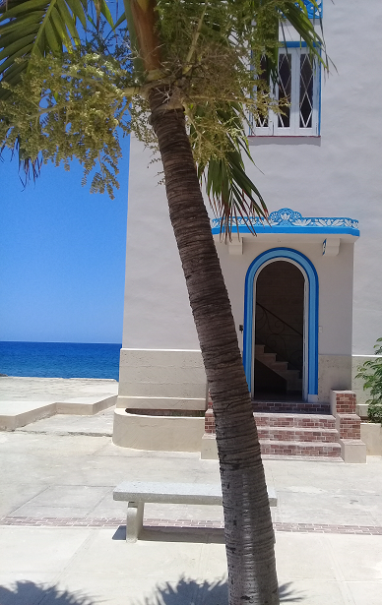


Science and Technology Interface Society of the Technological University of Havana "José Antonio Echeverría"
DAVID CARMONA Y ASOCIADOS
Experts... Responsible... Qualified... Committed…
Desde 1999

Slide 2
CONSTITUTION
2019 - Decree No. 363/2019 of the Council of Ministers
Technological University of Havana "José Antonio Echeverría"
Central University "Marta Abreu" of Las Villas
SHAREHOLDERS

Slide 3

SOCIAL OBJECT
The management of marketable research, development and innovation projects; the transfer of technology, the realization of consultancies and advisory services associated with the projects and commercialization of other intangibles, with the participation of professors, researchers, students and specialists from different institutions, achieving sustainability.
Puntos destacados y actualizaciones
Añade animaciones y transiciones de página a tu presentación de Canva para enfatizar las ideas y hacerlas aún más memorables.

Slide 4

OUR STRENGTH
Excellence in the transfer of technologies, consultancies and advisory services, commercialization of research products, as an interface between universities and Entities of Science, Technology and Innovation with the productive and service sector; both nationally and internationally, with the participation of highly qualified and committed professors, support staff, researchers, students, technicians, and specialists from different institutions, highly qualified and committed with science and innovation. .

Slide 5




PROJECTION
Constitution
Start of activities
Organization
Projection
Work model
Consolidation
Improvement
Increase
Alliances
Developing
Sustainability
internationalization
2023-2025
2021
2020
2022

Slide 6




ACTIONS
Balance
Desde el 1 de enero de 2025
395 CONTRACTS
186 NATIONAL COMPANIES
37 FOREIGN COMPANIES
PROJECTS STI: 5
PROJECTS PSS: 268
EVENTS: 3
NEW ECONOMIC ACTORS: 6
COUNTRIES: 12

Slide 7




IN NUMBERS
2021
INDICATORS
2022
177
CLIENTS
223
+26%
278
CONTRACTS
395
+42%
280
SPECIALISTS
401
+43%
15
STUDENTS
70
+366%
+1400
TRAINED SPECIALISTS
+1700
+21%

Slide 8
INCOME

Slide 9
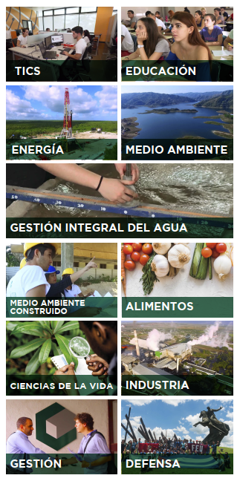
MAIN RESULTS
Consulting to foreign companies not based in Cuba
Supervision and automatic control systems
Disaster risk study
Wind load studies and tower modeling
Modeling of coastal works
Design of concrete mixes
Evaluation and testing of dielectric media
RSE parks study
Electric Vehicle Assessment
Electric protections
Advice on the implementation of the strategic projection
Advice for process improvement
Organizational strategic design
Digital transformation strategy evaluation
Data mining in management and decision making
Route optimization
Customization of information systems
Monitoring and analysis of opinions in digital media
Maintenance management
Strategy in the use of renewable energies
Technological surveillance
Introduction of projects and products in Cuba
Study of products for export
Information systems support
Building re-functionalization project
Safety and security applications
Customized specialized training

Slide 10
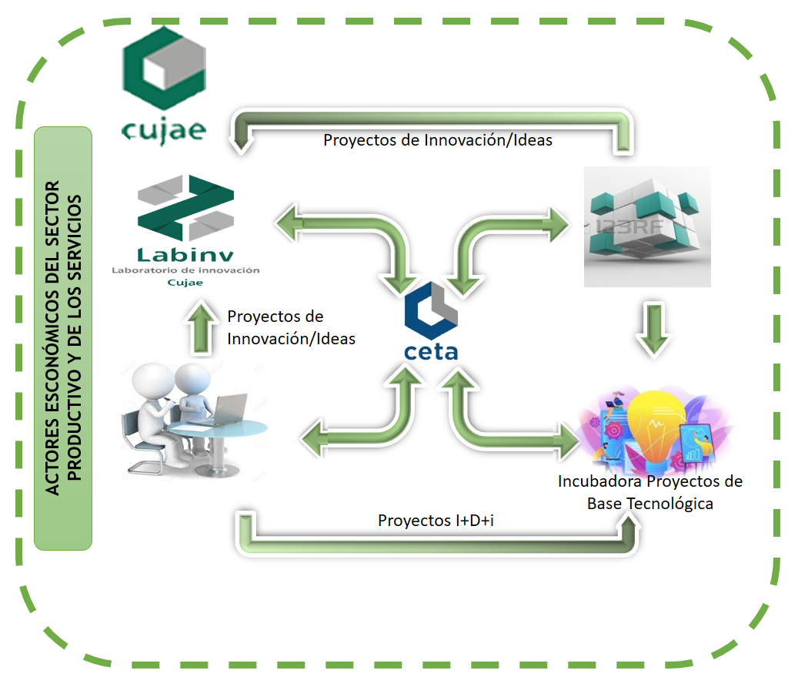
OBJECTIVE:
create capacities for the incubation of technology-based solutions that integrate the different specialties of technical sciences in alliances with the productive and service sectors
INNOVATION ECOSYSTEM

Slide 11

MAIN CONTRIBUTIONS:
SUSTAINABILITY AND GROWTH
DEVELOPMENT OF THE CULTURE OF INNOVATION AND EXPORT
KNOWLEDGE OF THE INDUSTRY AND NATIONAL MARKET
DEVELOPMENT OF PROJECTS AND PRODUCTS
WORK IN MULTIDISCIPLINARY TEAMS
PRODUCTIVE LINKS
NATIONAL AND INTERNATIONAL ALLIANCES
ACCESS TO SOURCES OF INTERNATIONAL FINANCING
CUSTOMIZING YOUR SOLUTION
TRAINING - ACTION MODEL

Slide 12

WORK CHALLENGES:
INTERNATIONALIZATION
DEVELOPMENT OF EXPORTABLE PRODUCTS AND SERVICES
CONTRIBUTE TO THE DEVELOPMENT OF THE SCIENCE INFRASTRUCTURE
INTEGRATION OF SPECIALISTS AND STUDENTS
INCREASE ALLIANCES AND CHAINS
IMPROVE THE WORK MODEL
DEVELOPMENT OF A COMMUNICATION MODEL
MANAGE MULTIDISCIPLINARY PROJECTS AND PRODUCTIVE CHAINS
INTEGRATION WITH THE GOVERNMENT
DEVELOPMENT AND STRENGTHENING OF THE INNOVATION ECOSYSTEM

Slide 13
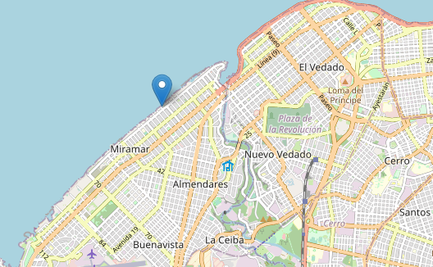




Danae Pigueiras Otero
President
+53 52152758
+53 72040745
director.ceta@tesla.cujae.edu.cu
www.tecnoceta.com
AT YOUR SERVICES
twitter.com/@cetacujae
www.facebook.com/ceta.cujae

