Slide 1
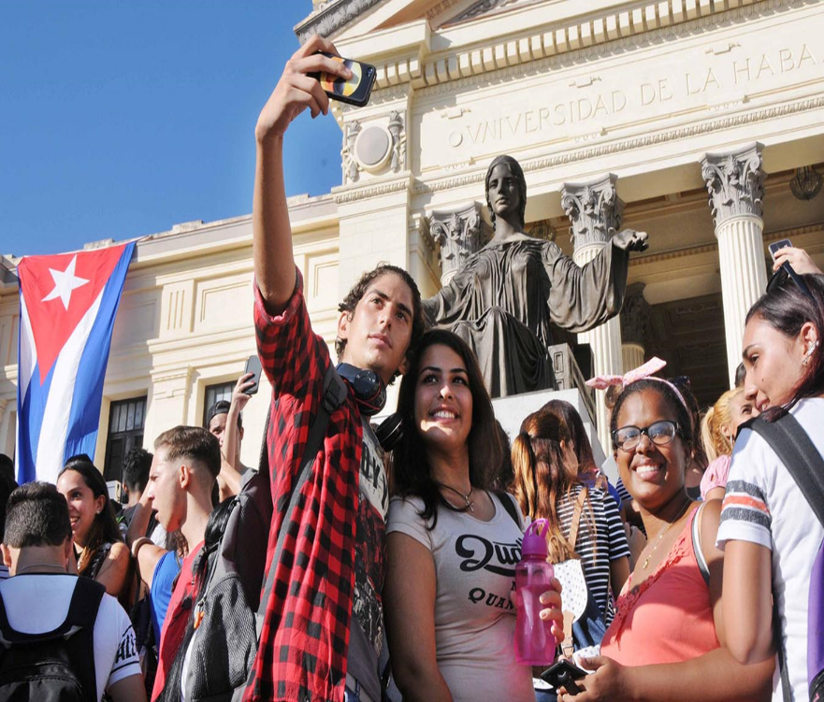
Dr.Sc. Ondina León Díaz
General Director of Research and Postgraduate Studies
Ministry of Higher Education, Cuba.
Full member of the Cuban Academy of Sciences.
Doctor in Agricultural Sciences and Doctor of Sciences.
Researcher and Full Professor.

Slide 2
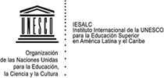
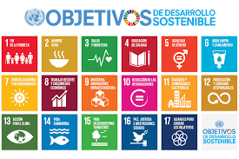
HIGHER EDUCATION
&quot; Education is a fundamental right that is the basis of the progress of any country.&quot;
Higher education must be the responsibility of all governments. CMES – 2009
Higher education is a social public good, a human and universal right and a duty of the State. CRES 2008/2018
A human and universal right
Sustainable Development Goals (SDGs)
2015-2030

Slide 3
MISSION OF THE UNIVERSITIES
PRESERVE
DEVELOP
PROMOTE
UNIVERSITY
SOCIETY
FORMATION
SCIENCE AND
INNOVATION
EXTENSION

Slide 4
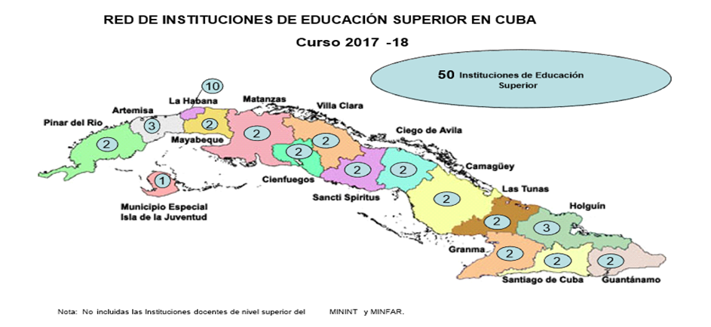
CUBAN HIGHER EDUCATION
There are 50 institutions of
Higher Education: 25 are from
MES.
There are 194,723 students in 112 majors and 58 senior technician programs.
Enrolled:
Daily Course: 126 681
Course by Meetings: 131 816
Distance Course: 11 328
There are 17 800 full-time and part-time teachers and 7 388 researchers.
Doctors in Sciences 4 298 and 12 417 Master of Science. 61.4% of the staff has the higher teaching categories of full professors and associate teachers.
About 35% are under the age of 35.

Slide 5
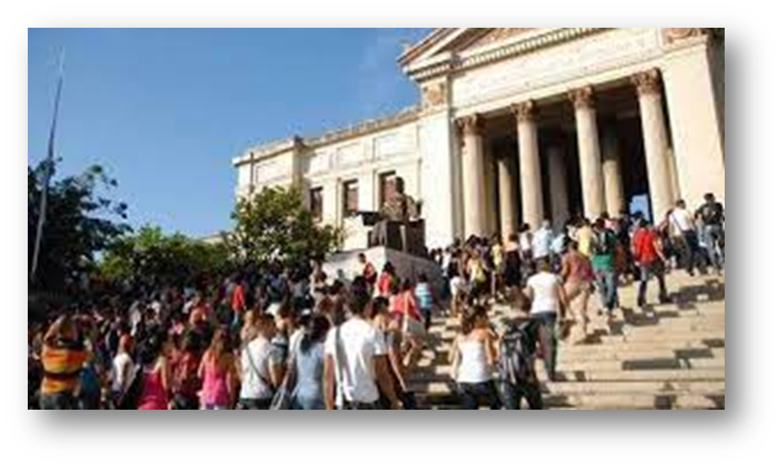
CUBAN HIGHER EDUCATION
Pedagogical sciences
Social sciences and humanities
Basic, natural and technical sciences.
Agricultural sciences
Economics
Sciences of physical culture and sport.

Slide 6
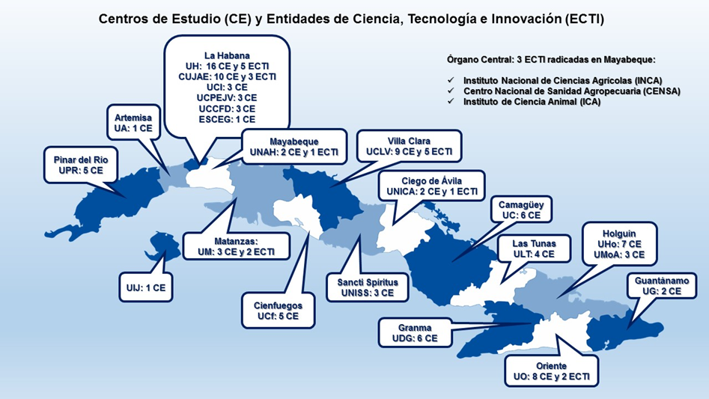
CUBAN HIGHER EDUCATION
Research centers (CE), science, technology and innovation entities (ECTI)
Research centers: 100
122 Municipal university centers (CUM)
Science, Technology and Innovation Entities: 27
Dynamic structures of science: 10 (science and technology parks, interface enterprizes and foundations).

Slide 7
CUBAN HIGHER EDUCATION
The following are taught in postgraduate studies:
Courses, Diplomas, Trainings
Postgraduate Specialities: 177
Masters Programs: 380
Doctoral Programs: 136

Slide 8
EXPECTED IMPACTS BY THE SOCIETY
Training and upgrading of executives
Generation of knowledge, creation of capacities, development and application of products, services and tecnologies to improve living conditions, substitution of imports and exports through R+D+I processes
Contribution to territorial and local development
Ongoing training of professionals
Training for the profession
Postgrauate training
Connecting knowledge to the economy and society

Slide 9
INNOVATION IN THE PROCESS OF UNIVERSITY TRAINING
Break with the traditional educational paradigm centered on the teacher and content for the transmission and reproduction of information.
Student-centered with active learning didactic strategies that teach how to operate with information and transform it into knowledge.
In the link of theory with practice.
Research component: Curricular and extracurricular research.
SOLUTIONS TO PROBLEMS
Notes:
En la actualidad, cambios transcendentes tienen lugar en la educación superior como resultado de la implementación de los Lineamientos de la Política Económica y Social del Partido y la Revolución aprobados en el año 2010 para actualizar el modelo económico y social cubano, y que fueron renovados para el período 2016-2021 (Se aprobaron en el VI y VII Congreso del Partido respectivamente).
En el año 2015, el MES presentó el documento ¨Política para el perfeccionamiento del sistema de formación continua de los profesionales cubanos¨ en el cual se realiza una caracterización de la educación superior cubana, se recoge un diagnóstico de la situación actual con referencia a los tendencias internacionales asumidas y se trazan un conjunto de políticas a implementar con vistas a lograr niveles superiores de calidad en la formación, tomando como referente el contexto internacional y adecuándolo a las características presentes en el país.
Comentario: Este documento fue ampliamente debatido y enriquecido en diferentes escenarios académicos y, finalmente, fue aprobado en el consejo de dirección del MES y elevado a los niveles superiores.
Explicar brevemente cada una de las políticas que le atañen directamente a la DFP, argumentando las acciones principales realizadas, los resultados alcanzados en su implementación hasta la fecha y las principales tareas a emprender en el presente curso académico.
Comentario: De las 11 políticas aprobadas, 5 le atañen directamente a la DFP

Slide 10
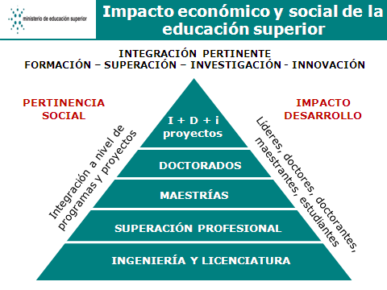
INTEGRATED MANAGEMENT OF TRAINING – SCIENCE. TECHNOLOGY AND INNOVATION
SOCIAL RELEVANCE
IMPACT
DEVELOPMENT
I+D+i
projects
Doctorate programs
Integration at the level of
programs and projects
Leaders, PhDs, doctoral
and master students, students
Master programs
Professional development
Engineering and bachelors
UNDERGRADUATE STUDENTS (CURRICULAR AND EXTRACURRICULAR RESEARCH)

Slide 11
SCIENCE, TECHNOLOGY AND INNOVATION
STRENGTHENING SCIENCE, TECHNOLOGY, INNOVATION AND DOCTORAL TRAINING
Strengthen the activity of science, technology, innovation, doctoral and postdoctoral training through the priority in the lines of research, the concentration of human, financial and material resources and the support of international relations; articulating it harmoniously with undergraduate and postgraduate training, to achieve sustainable impacts on the economy and society.

Slide 12
INTEGRATED MANAGMENT OF TRAINING – SCIENCE, TECHNOLOGY AND INNOVATION
Postgraduate studies , doctoral programs and postdoctoral research linked to research lines and research projects
International collaboration with institutions of excellence
Recognitions and awards to students, professors and researchers
Relationship with the society and the socio-productive environment to enhance economic and social impacts
Environment of debate and control, scientific criticism, rigor, high quality standards and ethical values
Lines of research, priorities and interdisciplinary, transdisciplinary and multidisciplinary projects
STRATEGIES

Slide 13
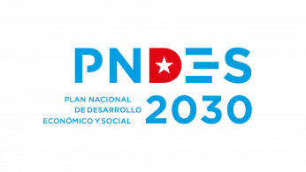
Economic and Social Development Plan (PNDES) until 2030. Macroprograms. Strategic axis of human potential and Science, Technology and Innovation (STI).
Public policies of STI, undergraduate and postgraduate studies.
Government system based on science and innovation, social communication and digitalization of society.
Implementation of public policies at the territorial level and decentralization of competences.
Strategic planning of the
Ministry of Higher Education

Slide 14
SOME RESULTS
A large number of experts are provided who participate with their knowledge in government decision making.
More than 50% of the national awards of the Cuban Academy of Sciences and innovation are from MES staffs.
More than 90 scientific journals in different areas of knowledge. Important production of books and softwares.
Five national programs and one sectorial program of MES itself are managed.
Wide range of training and postgraduate courses.

Slide 15
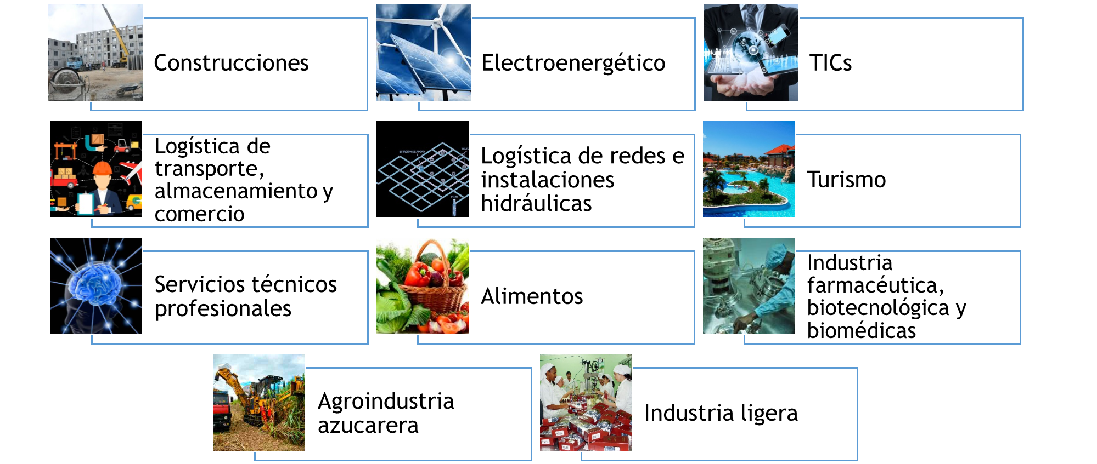
STRATEGIC SECTORS
Construction
Electroenergetics
ICTs
Transport logistics,
storage and trade
Logistics of hydraulic networks and installations
Tourism
Professional technical
services
Pharmaceutical, biotechnological, and biomedical industry
Food
Sugar
agroindustry
Light industry

Slide 16
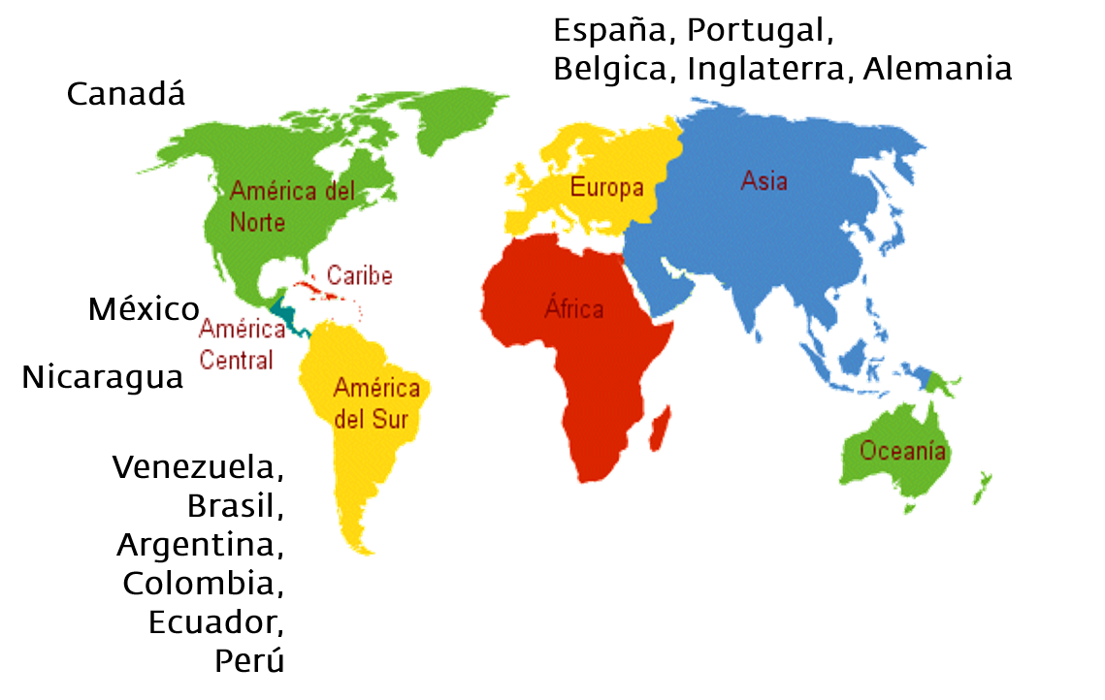
INTERNACIONALIZATION/SUSTAINABLE DEVELOPMENT
International cooperation that promotes development.
Estados Unidos
Rusia
Management of international cooperation projects, scholarships and research stays on strategic issues that pay tribute to doctorates.
China
Angola,
Etiopía, Mozambique,
Guinea Ecuatorial, Zimbabwe,
Sahara Occidental, Swazilandia
Increase income gains.
.
.

Slide 17
CONCLUSIONS
The social commitment is concretized in the impact of the university activity in the social, economic and cultural life of the community into which it is integrated, with a singular identity vision without ever losing the perspective of universality.
A committed, relevant and socially responsible higher education must contribute to the knowledge and solution, in its field and in accordance with its possibilities, of the problems and needs of society with the different actors.
We advocate for a model of scientific, technological, humanistic and innovative university, committed to its people, with its time, solidarity and internationalist. A university to which scientific research and postgraduate research is inherent, the dissemination of results, one which brings its knowledge to the people, of which it is part and learns (Diaz Canel, 2016).

Slide 18
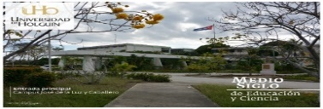
CONCLUSIONS
Higher education institutions are called upon to contribute, through the integration of their processes, to the country's development agenda and to the sustainable development goals.
The improvement of the Science, Technology and Innovation System is a requirement of first order to fulfill the social mandate of the university and ensure its sustainability.
The University, in a phase of institutional maturity, has the potential to assume and overcome the challenges imposed by the humanistic, scientific, technological and innovative university model; integrated into society, and deeply committed to the sustainability of the world in which we live.
Only creativity and innovation in the management of the university processes ensures the sustainability, relevance and advancement of higher education.

Slide 19
MAIN CHALLENGES
Continue:
Strengthening connections with society and the economy.
Further expanding access to higher education and motivation and capacity building for science and innovation.
Fostering interest in basic sciences.
Promoting the sector of high technological intensity.
Providing new dynamic structures of science: start up, joint laboratories, accelerators, small and medium-sized enterprizes, among others.
Strengthening the connection of higher education with territorial development.
Strengthening internationalization.

Slide 20
XIV International Congress on Higher Education,Universidad 2024
“Higher Education of the Future: social transformation, quality, relevance and sustainability”
The Higher Education Institutions are inviting you to participate, from February 5 to 9, in the XIV International Congress on Higher Education University 2024, at the International Conventions Center in Havana, Cuba in order to continue a dialogue and a reflection on its role in social and economic transformation, based on the principles of quality, sustainability and its relevance.

Slide 21
CUBAN HIGHER EDUCATION
Need for the harmonious integration of the economic, social, environmental and cultural vision of development and enhance ourselves as an innovative university, for greater interdisciplinary integration and university processes of training, research and extension, with a high relevance in function of the sustainable and inclusive development of our countries
Dr.C. José Ramón Saborido, Minister of Higher education

